Slide 1

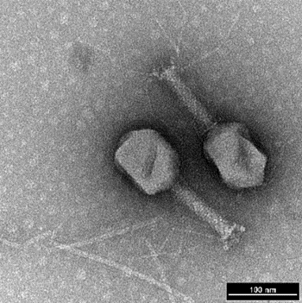

Bacteriophage Genomic Assembly, Annotation and Taxonomy Workshop March 18th – 20th 2025 DAY 3 Bacteriophage Research Lab Guelph RDC
Notes:
1

Slide 2


Agriculture & Agri-Food Canada Phage Genomics Workshop
Andrew M. Kropinski
Department of Pathobiology
University of Guelph, Canada
Email: Phage.Canada@gmail.com
Notes:
http://tbilisee.com/en/places/in/49-Education

Slide 3
PART 3
Taxonomy

Slide 4
Outline
History of phage taxonomy
Who is responsible for the taxonomy of phages?
How do I classify my phage?
How do I get my classification officially recognized?

Slide 5
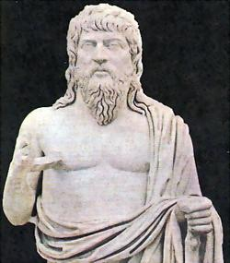
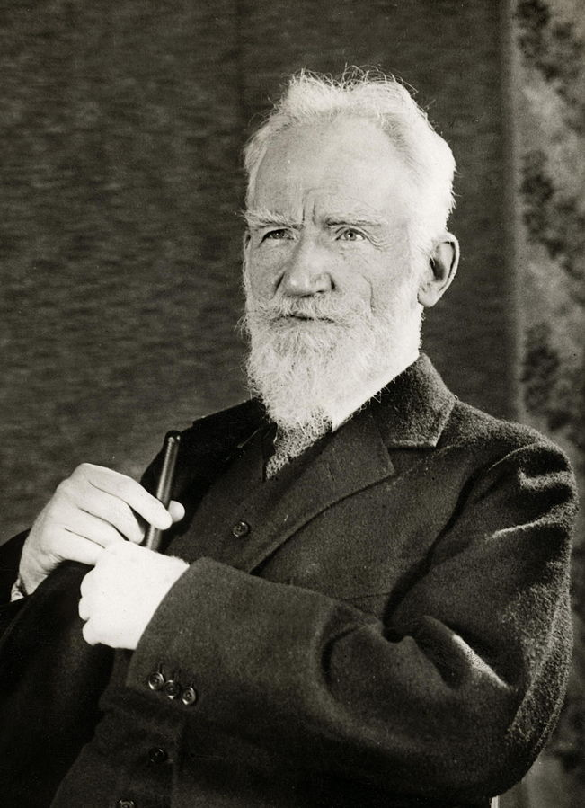

Nobody likes change but it is inevitable
“There is nothing permanent except change” (Heraclitus of Ephesus, c. 535 – c. 475 BCE)
“Progress is impossible without change” (George Bernard Shaw, 1856 – 1950)
“Intelligence is the ability to adapt to change” (Stephen Hawking, 1942 – 2018).

Slide 6



Taxonomy
Taxonomy is a human invention
It is not stable, with each generation comes a new viewpoint; plus, the plethora of new phages in GenBank give us a new perspectives on diversity & diversification
Bacterial viral taxonomy is the purview of ICTV – Bacterial Viruses Subcommittee
Taxonomy is controversial
Notes:
https://phagesdb.org/namerules/
(http://www2.bhpublishinggroup.com/supplies/products.asp?p=9780805439335)

Slide 7
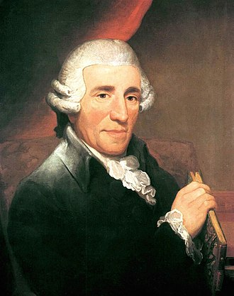
Franz Joseph Haydn (1732–1809) – The Creation/Die Schöpfung
Adam Lau, bass, singing the part of Adam about the newly created animals: lion, tiger, stag, horse, cattle, sheep, insects, and …
https://www.youtube.com/watch?v=fROA7ZQ8Htk
Notes:
1:57; He is now believed to have composed 473 pieces, including 108 symphonies, 47 piano sonatas, 20 operas, and 68 string quartets, among many other pieces https://www.youtube.com/watch?v=r2u4U3FhFC4

Slide 8
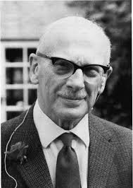
Sense and Nonsense in Bacterial Taxonomy (Samuel Tertius Cowan 1971)
Taxonomy is written by taxonomists for taxonomists; in this form the subject is so dull that few, if any, non-taxonomists are tempted to read it, and presumably even fewer try their hand at it.
…It is the most subjective branch of any biological discipline
…full-time taxonomists like to think of ourselves as artists able to perceive form, shape, colour and relationships that are hidden from the gaze of the more mundane scientists.
…like artists, we are argumentative and aggressive, we feel self-important and are scathing of the views of others.
Notes:
Journal of General Microbiology (I971), 67: 1-8

Slide 9
“I see all these characteristics in myself, thereby confirming that I am a successful taxonomist, and since the subject is armchair biology I expect to continue at it to a ripe old age.” (1905-1976)

Slide 10
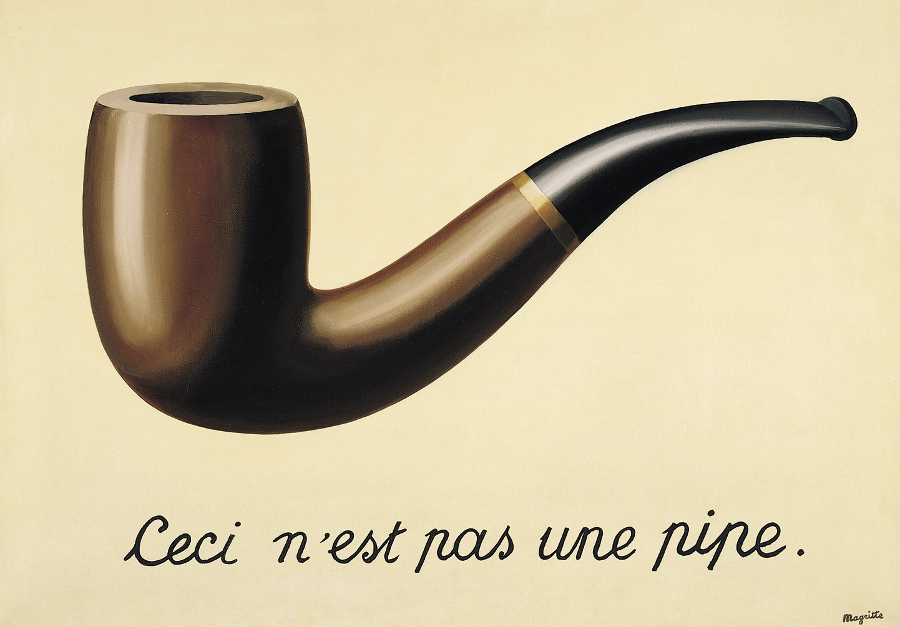
Take-home messages
Taxonomies change – e.g. Pseudomonas acidovorans, became Comamonas acidovorans, and now Delftia acidovorans
A taxon (a taxonomic group of any rank) is not an individual. Homo sapiens in a taxon, each one of you is an exemplar – an individual human being.
The Treachery of Images aka This is not a Pipe - Belgian surrealist painter René Magritte (Created: 1928–1929)

Slide 11
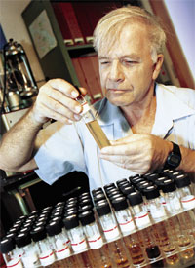

History of tailed phage taxonomy
1998
1 Order (Caudovirales), 3 Families, 15 Genera & 265 Species
Classification largely based upon morphology,
Life style (lytic, temperate) and host
2011
1 Order, 3 Families, 5 Subfamilies, 37 Genera & 135 Species
Classification using comparative proteomics
Classical Families were not monophyletic

Slide 12
History of phage taxonomy 2
2017
First new Family introduced – Ackermannviridae
Classification using comparative genomics
2019
ICTV introduced 15 ranks (realm, subrealm, kingdom, subkingdom, phylum, subphylum, class, subclass, order, suborder, family, subfamily, genus, subgenus, and species). Where realm (viruses) ≡ domain (bacteria)
2022
Caudovirales and its three Families abolished

Slide 13
History of phage taxonomy 3
2023
Latinate binomial taxonomy mandated
1 Class (Caudoviricetes), 11 Orders, 105 Families, 132 Subfamilies, 1680 Genera & 5799 Species
None of this would be possible without new bioinformatic/taxonomic tools and insights
Exemplar
Taxon
Salmonella phage P22
Pseudomonas phage Jeff
Lederbergvirus P22
Pbunavirus jeff
2025

Slide 14
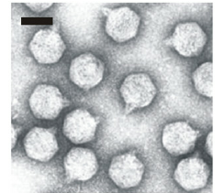
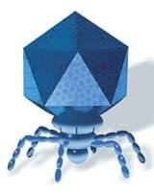
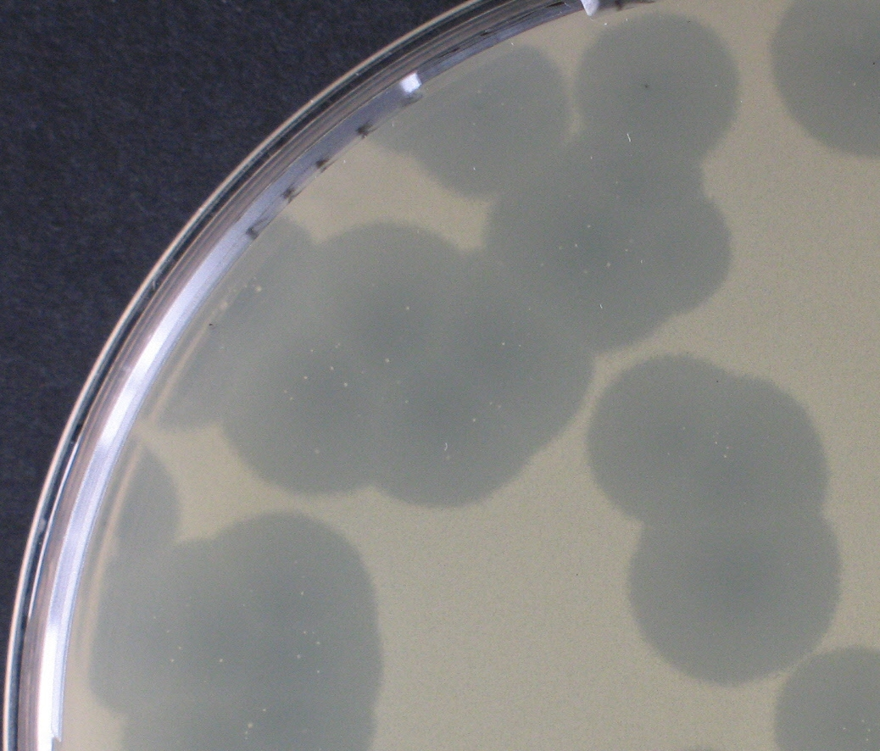
Phage T7 - 2008
In 2008 – genus “T7-like phages” with three species: T7, Kvp1 and gh-1
Notes:
https://www.dsmz.de/collection/catalogue/details/culture/DSM-4623

Slide 15
Phage T7 - 2025
In 2025 – one Order (Autographivirales), four Families, 13 Subfamilies, 227 genera and 723 species
Escherichia phage T7 – Teseptimavirus T7
Kluyvera phage Kvp1 – Berlinvirus Kvp1
Pseudomonas phage gh-1 – Ghunavirus gh1
The name of your phage is: (Host genus) + phage + name DO NOT name your phage with the taxon name
Notes:
https://www.dsmz.de/collection/catalogue/details/culture/DSM-4623; Pbunalikevirus T7, or Pbunavirus T7

Slide 16

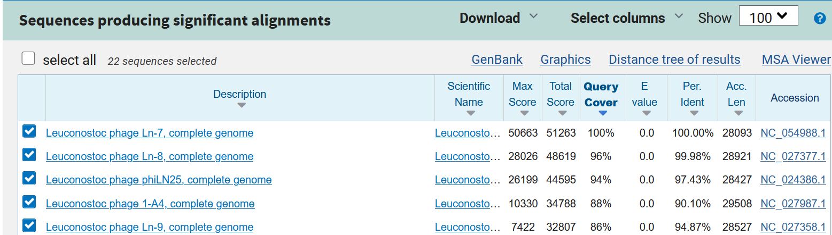
Practical viral taxonomy
BLASTn versus Caudoviricetes (taxid:2731619)
you may have to increase the “Max target sequences” under “algorithm parameters”
Download Fasta (complete sequence) as “seqdump.txt”

Slide 17
Accession number versus RefSeq number
GenBank is part of the International Nucleotide Sequence Database Collaboration, which comprises the DNA DataBank of Japan (DDBJ), the European Nucleotide Archive (ENA), and GenBank at NCBI.
exchange information
RefSeq records are distinguished from INSDC records by: Accession format: The most distinguishing feature of a RefSeq record is the distinct accession number format that begins with two characters followed by an underscore (e.g., NP_). INSDC accession numbers never include an underscore
The RefSeq database - NCBI

Slide 18
Massaging fasta file
Change fasta line from:
to:
N.B. If you are satisfied with just the accession or RefSeq number don’t do anything

Slide 19
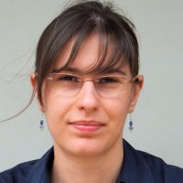
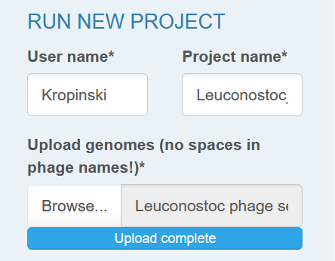
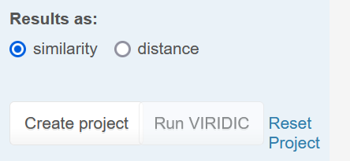

Submit to -
VIRIDIC
https://rhea.icbm.uni-oldenburg.de/viridic/
complete and upload
Save project number: Current project ID: P4253 ___Kropinski___Leuconostoc_phages___ 20250207183018

Slide 20
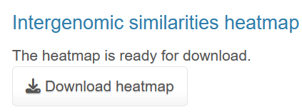
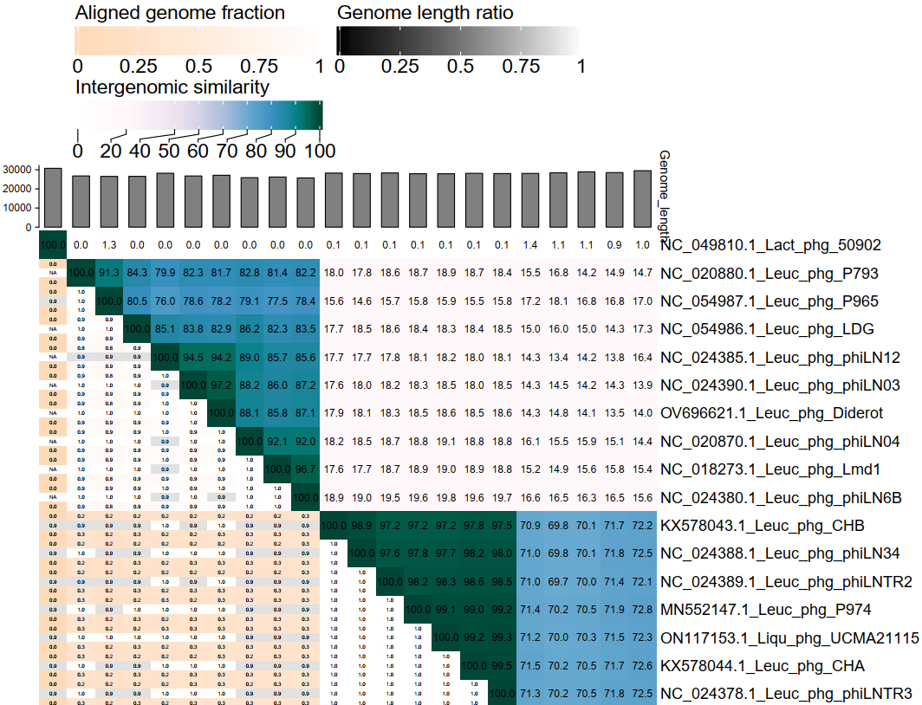


VIRIDIC heatmap 1
Notes:
Liquorilactobacillus phage UCMA21115: Zheng, J., Wittouck, S., Salvetti, E., Franz, C.M.A.P., Harris, H.M.B., Mattarelli, P., O'Toole, P.W., Pot, B., Vandamme, P., Walter, J., Watanabe, K., Wuyts, S., Felis, G.E., Gänzle, M.G., and Lebeer, S. "A taxonomic note on the genus description of 23 novel genera, emended description of the genus Lactobacillus Beijerinck 1901, and union of Lactobacillaceae and Leuconostocaceae." Int. J. Syst. Evol. Microbiol. (2020) 70(4):2782-2858.

Slide 21

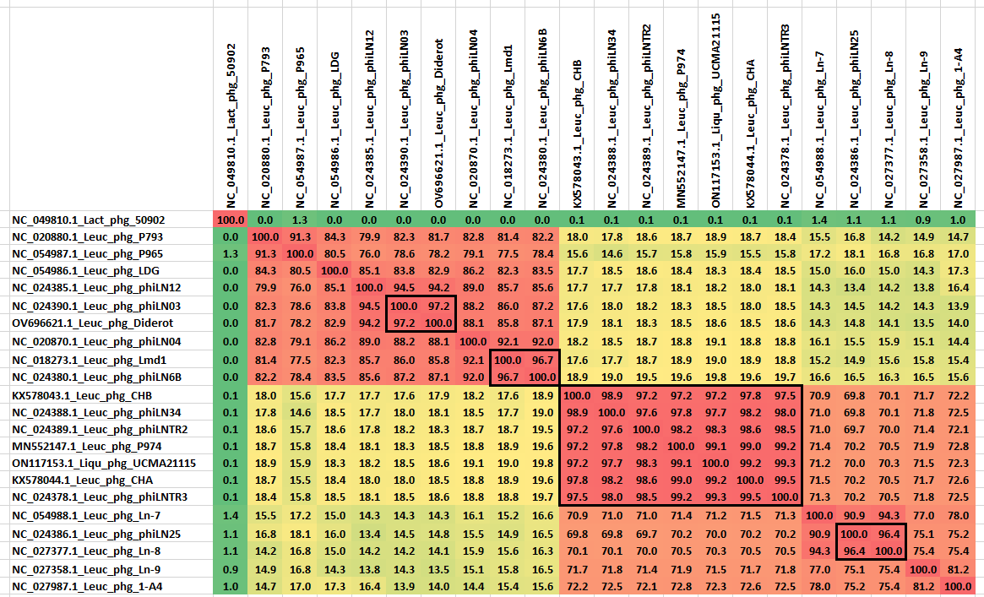
VIRIDIC heatmap 2
Open with Excel

Slide 22

Taxonomy using taxMyPhage
Andrew Millard, University of Leichester UK
https://www.liebertpub.com/doi/full/10.1089/ .2024.0050 - publication
Website: https://ptax.ku.dk/
Classify dsDNA phages at the genus and or species level only
It will NOT compare against or phages in NCBI, only species that are classified by ICTV
OK for lytic phages, less so for temperate ones

Slide 23
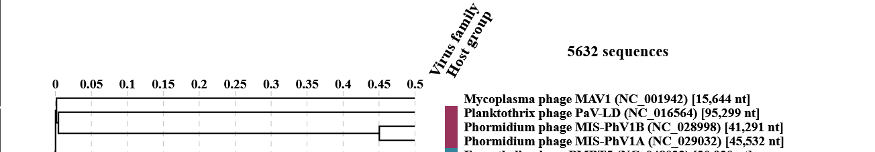
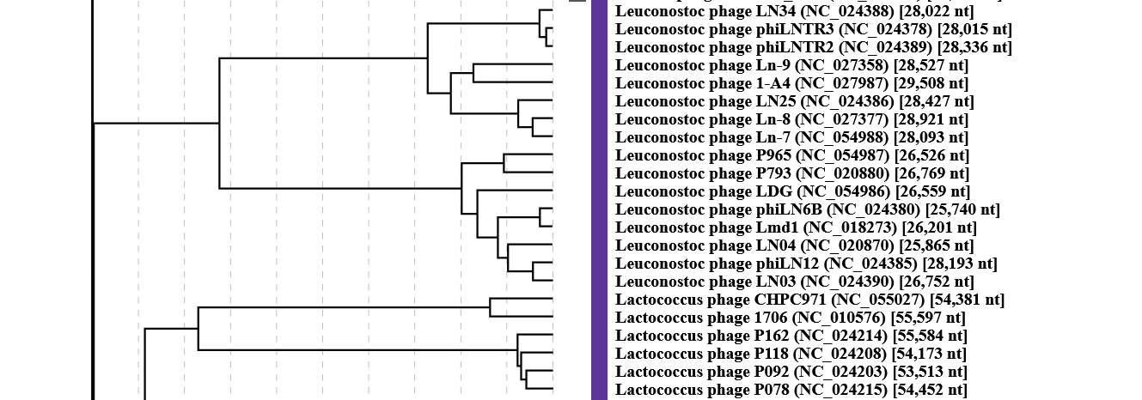
Submit to -
ViPTree
takes some time to complete - tBLASTx
https://www.genome.jp/viptree/upload
complete and upload

Slide 24
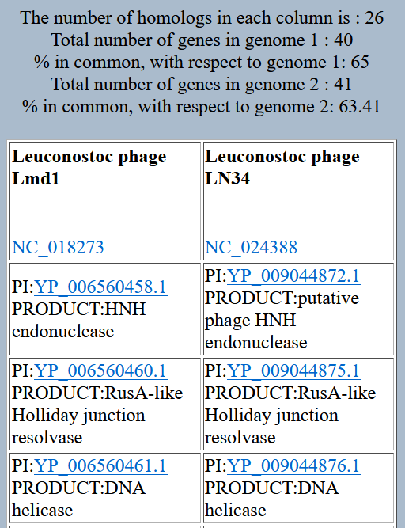
Shared proteins - CoreGenes
CoreGenes 5.0 (https://coregenes.ngrok.io/) CoreGenes 3.5 (http://binf.gmu.edu:8080/CoreGenes3.5/)
High % of homologous proteins - Subfamily

Slide 25
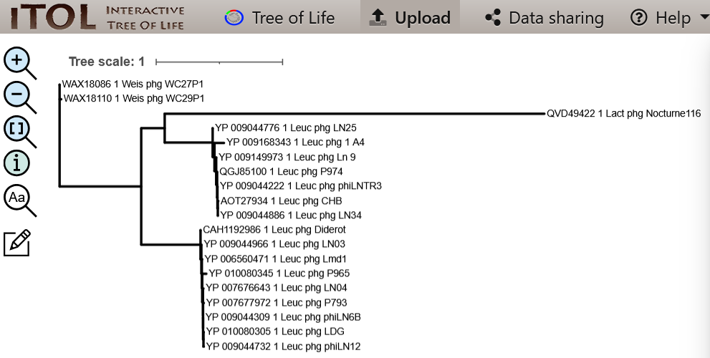
Phylogeny
“One Click” at https://ngphylogeny.fr/
Lemoine F et al. 2019. Nucleic Acids Res. 47(W1): W260-W265. doi: 10.1093/nar/gkz303. PMID: 31028399
latter program interfaces with iTOL

Slide 26
Phylogeny 2
in some cases a phylogenetic tree based upon a single protein doesn’t support the proposed taxonomy; repeat with a polyprotein

Slide 27

Higher taxons – new families etc.
Current focus of BVS/ICTV
vConTACT3 - Matthew B. Sullivan (Ohio State University) https://microbiomejournal.biomedcentral.com/articles/10.1186/s40168-024-01876-z
VirClust – Cristina Moraru
Publication: https://pubmed.ncbi.nlm.nih.gov/37112988/
Server: https://rhea.icbm.uni-oldenburg.de/virclust/
GRAViTy-V2 – Peter Simmonds, University of Oxford
Publication: https://academic.oup.com/nargab/article/6/4/lqae183/7928175

Slide 28
Take home message 2
Name your isolated after the primary isolation host i.e. Escherichia phage xxx
Check Adriaenssens & Brister (2017). How to Name and Classify Your Phage: An Informal Guide (https://www.mdpi.com/1999-4915/9/4/70)

Slide 29
Take home message 3
Consult the ICTV website (https://ictv.global/) for the latest taxonomy
Consider sending an email to the Bacterial Viruses Subcommittee
Be willing to accept that you isolate may be currently a genomic orphan
Consider submitting an International Community on Taxonomy of Viruses (ICTV) Taxonomy Proposal (TaxoProp)

Slide 30
ICTV Documentation
ICTV Taxonomy Proposal: two parts (Word & Excel) https://ictv.global/taxonomy/templates

Slide 31
ICTV Documentation 2
Species demarcation criteria: Two phages are assigned to the same species if their genomes are more than 95% identical over their genome length for isolates. These values can be calculated by a number of tools, such as BLASTn [1,2] – usually calculated using intergenomic distance calculator VIRIDIC [3].
Genus demarcation criteria: In search for criteria that create cohesive and distinct genera that are reproducible and monophyletic, the Bacterial Viruses Subcommittee has established 70% nucleotide identity of the genome length as the cut-off for genera. Genus-level groupings should always be monophyletic in the signature genes, as tested with a phylogenetic tree. [10]
Subfamily demarcation criteria: Subfamilies are to be created when two or more genera are related below the family level. In practical terms, this usually means that they share a low degree of sequence similarity (usually about 40-50%) and that the genera form a clade in a marker tree phylogeny. [10]
Family demarcation criteria: The family is represented by a cohesive and monophyletic group in the main predicted proteome-based clustering tools (VirClust, ViPTree, GRAViTy dendrogram, vConTACT2 network). Members of the family share a significant number of orthologous genes (the number will depend on the genome sizes and number of coding sequences of members of the family). [10]

Slide 32
Comparative genomics and proteomics
Classical
progressiveMauve - Darling AE et al. 2010. PLoS One 5(6): e11147. doi: 10.1371/journal.pone. 0011147. PMID: 20593022
Mac, not PC OR
https://usegalaxy.eu/
Easyfig - Sullivan MJ et al. 2011. Bioinformatics 27(7): 1009-10. doi: 10.1093/bioinformatics/ btr039. PMID: 21278367
http://mjsull.github.io/Easyfig/files.html

Slide 33
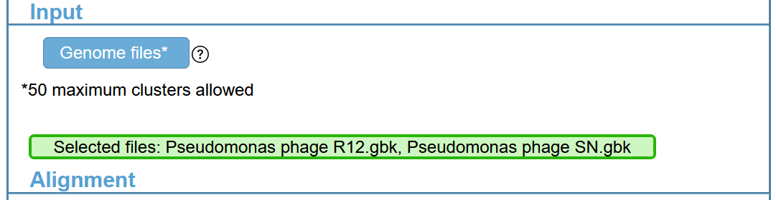
Comparative genomics and proteomics
Modern
clinker at CAGECAT - CompArative GEne Cluster Analysis Toolbox
Gilchrist CLM & Chooi YH. 2021. Bioinformatics. 37(16): 2473-2475. doi: 10.1093/bioinformatics/ btab007. PMID: 33459763
https://cagecat.bioinformatics.nl/
input: gbk files

Slide 34
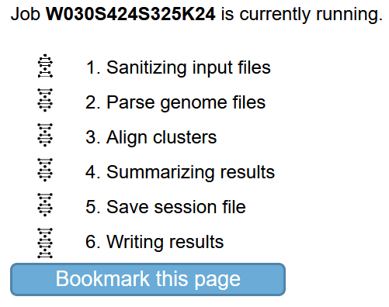
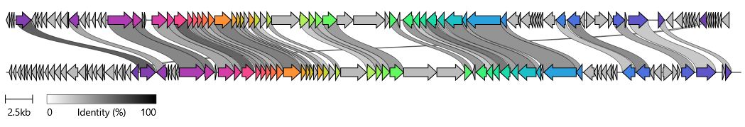
clinker 2
Pseudomonas phage SN
Pseudomonas phage tabernarius

Slide 35

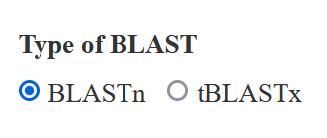
DiGAlign - Dynamic Genomic Alignment
requires: poly fasta-formatted genomes
Nishimura Y et al. 2024. Microbes Environ. 39(1): ME23061. doi: 10.1264/jsme2.ME23061. PMID: 38508742
https://www.genome.jp/digalign
Valid email address required

Slide 36
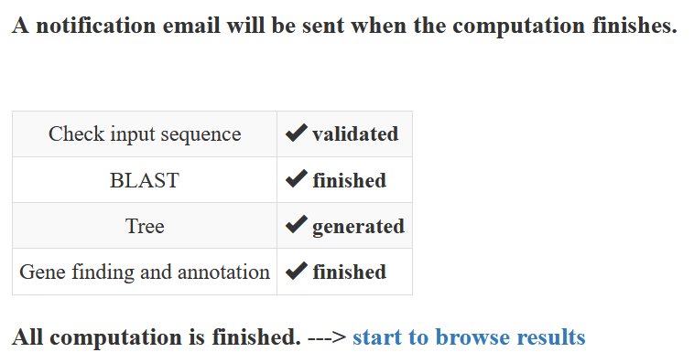
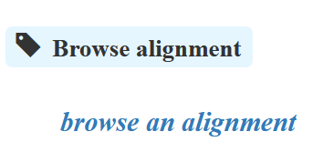
DiGAlign 2

Slide 37
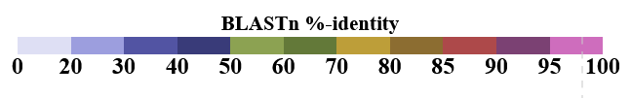
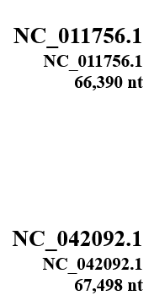
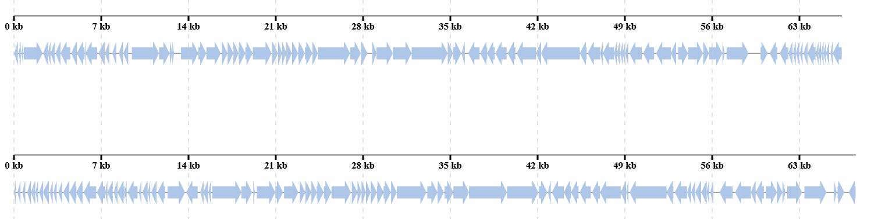
DiGAlign 3
BLASTn
No homology

Slide 38
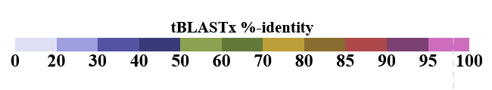
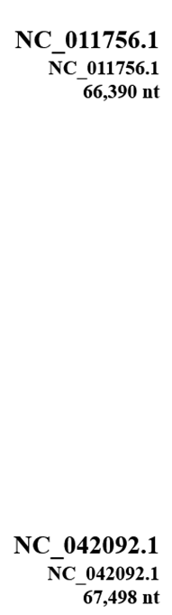
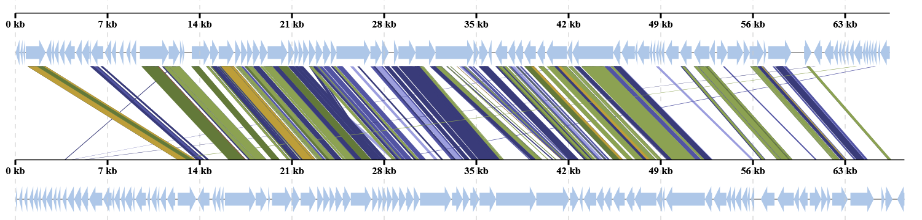
DiGAlign 4
tBLASTx

Slide 39

End of Part 3
Questions?

Slide 40
Supplementary File – Therapeutic Potential
Yukgehnaish K et al. PhageLeads: Rapid Assessment of Phage Therapeutic Suitability Using an Ensemble Machine Learning Approach. Viruses. 2022; 14(2):342. doi: 10.3390/v14020342. PMID: 35215934; PMCID: PMC8879740.
ABRicate at https://usegalaxy.org/
determining the presence of temperate markers (integrase, Cro/CI repressor, immunity repressor, DNA partitioning protein A, and antirepressor)
& antibiotic resistance genes and virulence genes

